Slide 1
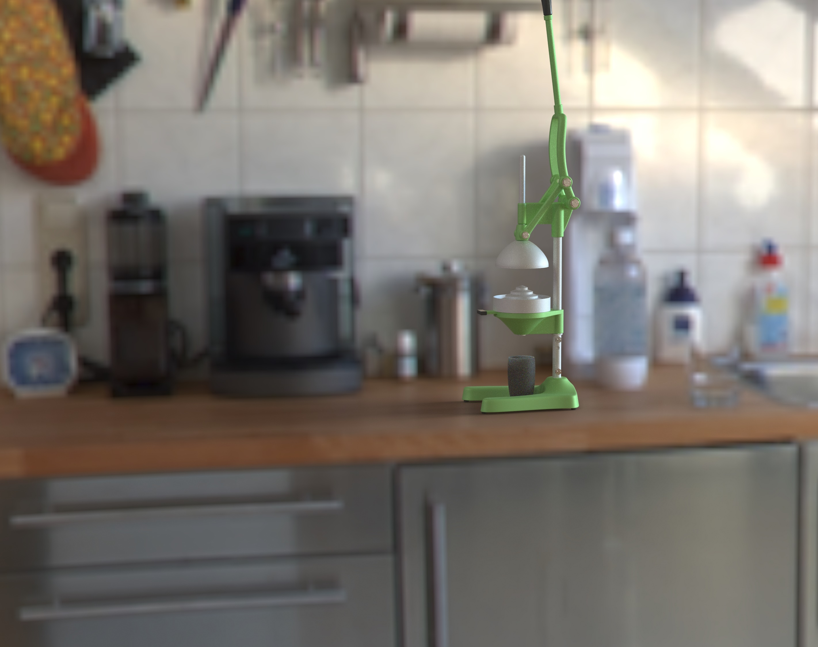
Mechanical Citrus Juicer
Selin Rabia Kinsiz 122207037
Zehra Füreyya Erdoğan 122207074

Slide 2
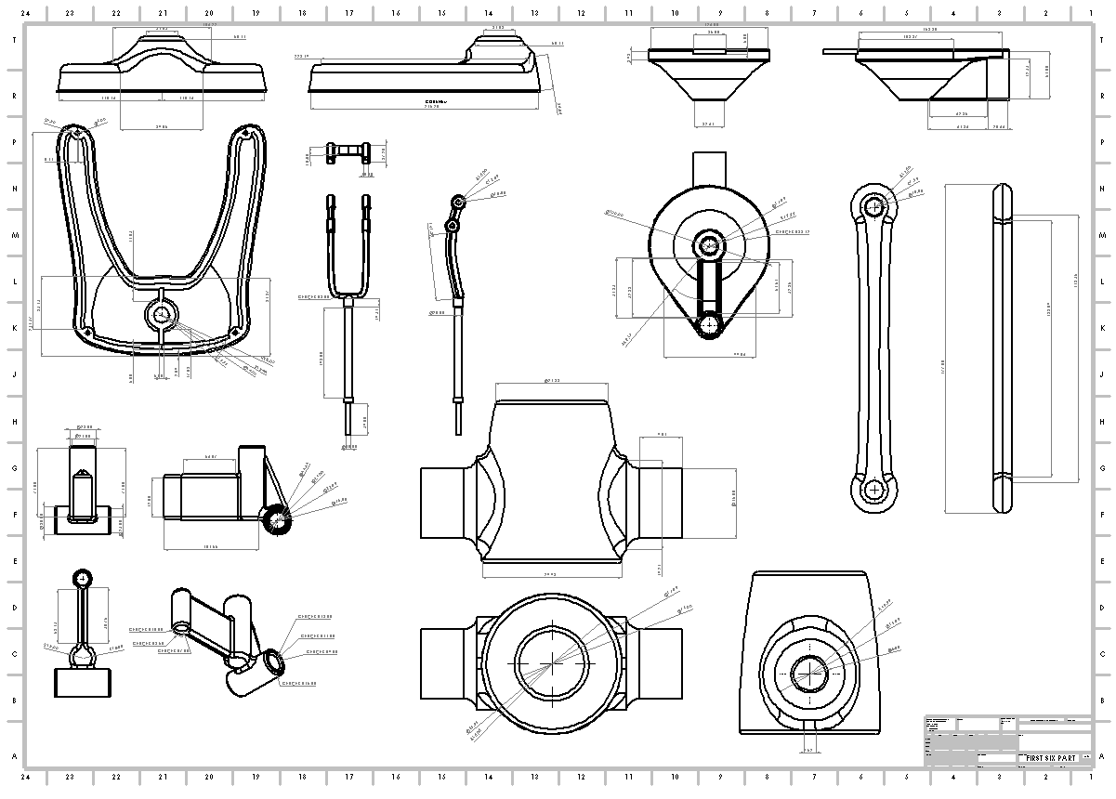
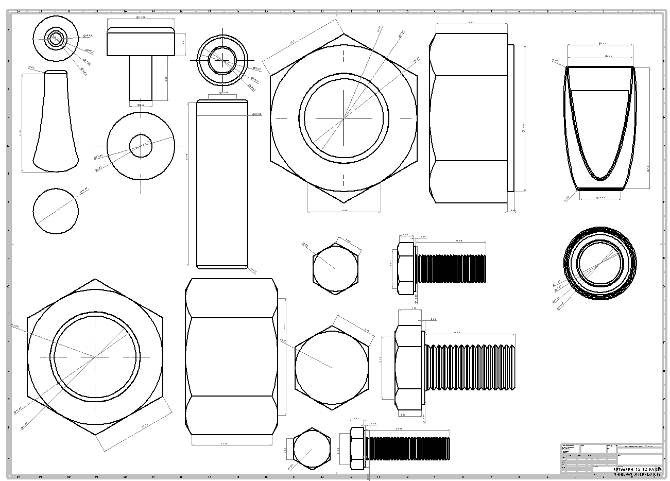

Slide 3
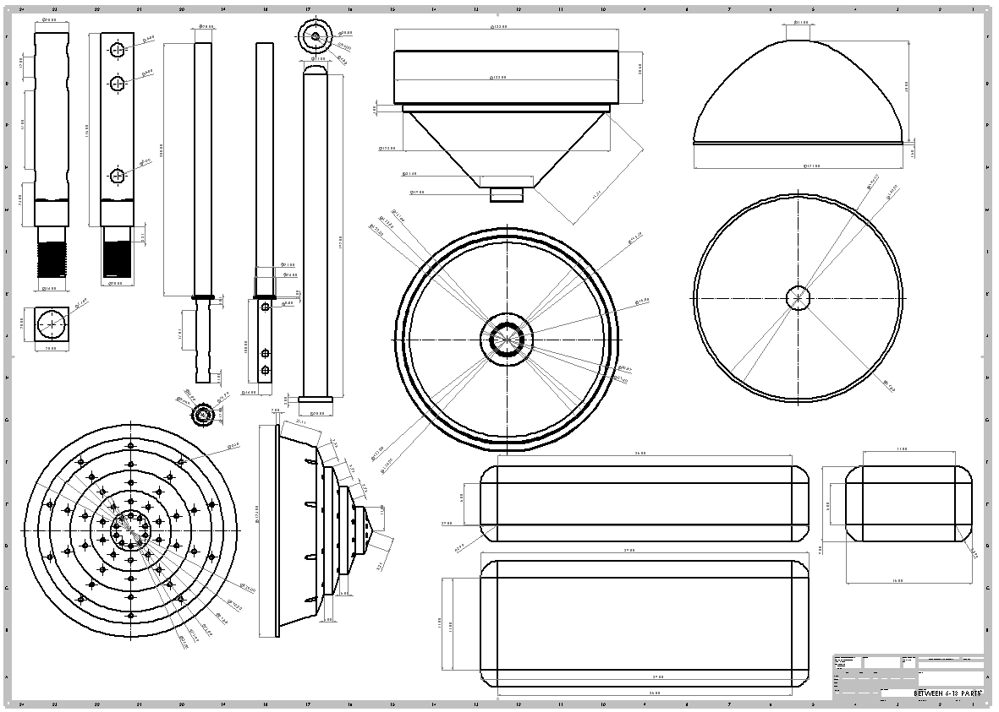
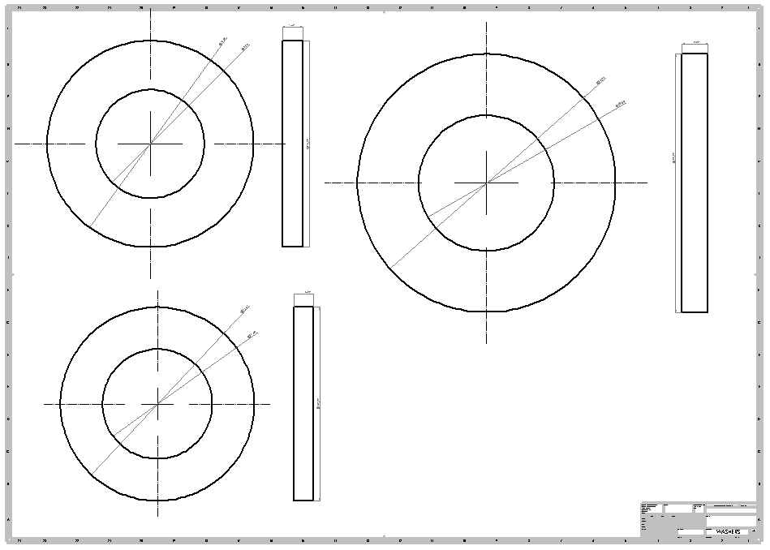

Slide 4
Parça render

Slide 5


Slide 6


Slide 7
